Slide 1
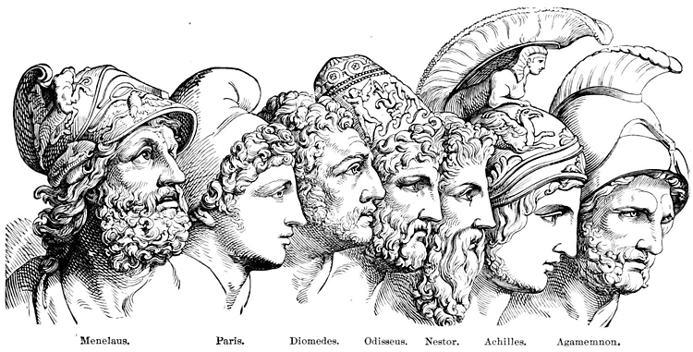
The Trojan War

Slide 2
What is an “epic”?
An epic is a long poem which tells a story involving supernatural influences & heroic feats.
Events from epics come from stories that have been passed down; they are not based on historical fact
Typically, epics were shared orally through narration and music.
Epics cover a long span of time and vast arrays of locations.
The purpose of the epic was to spread beliefs and values important to the culture of an area and its people.

Slide 3
Eris, the Goddess of Discord, was not invited to a fancy wedding, so she threw an apple labeled “to the fairest” into the banquet hall, knowing it would begin a fight between the goddesses.
Zeus, unable to choose between Hera, Aphrodite, and Athena, chose Paris, the cowardly son of King Priam of Troy to settle the dispute. King Priam had been warned in a prophecy that his son would one day cause the downfall of Troy. (foreshadowing!)

Slide 4
The goddesses offered various bribes to win Paris’ favor. Hera promised him all the lands of Europe & Asia, Athena promised to let him lead the Trojans in battle against the Greeks, and Aphrodite promised him the most beautiful woman in the world.
What did he choose…

Slide 5
The hot girl, of course… Aphrodite got the golden apple and promised Paris Helen, the fairest woman in the world. Unfortunately, Helen was already married to Menelaus, the King of Sparta and the brother of Agamemnon, the King of the Greeks. This was NOT good…

Slide 6
Paris showed up as a guest of King Menelaus. Greek custom is that guests are God-sent and that there is a sacred bond between guest and host.. Paris shredded that bond when he took Menelaus’ wife. Versions of the story vary – sometimes she goes willingly because Paris is so handsome; sometimes he forces her against her will. Definitely changes your perspective on the whole story…

Slide 7
Helen is often referred to as the “face that launched 1,000 ships” because of the uprising her disappearance caused in Greece & Sparta. When she was single, her beauty brought forth many suitors who fought for her affections. Her father wisely made them all promise that they would defend the one he chose for his daughter. That’s why so many brave warriors rose up to help Menelaus get his precious wife back from Troy. (People kept their promises back then!)

Slide 8
The Greeks had many difficulties before they could even depart for Troy, including:
The smartest of the Greeks, Odysseus, pretended to be insane to avoid leaving his family to fight a war. He pretended to be plowing his field with salt, but when the Greeks threw his baby son in front of the plow to test him, he caved in and agreed to go fight.
Achilles was kept back by his mother who knew that he was destined to die at Troy, and she tried to disguise him as a GIRL, but the Greeks found him, and he was anxious to fight.
Artemis was angry with the Greeks for killing a wild hare & her young, so she calmed the winds and demanded the sacrifice of Agamemnon’s daughter Iphigenia.

Slide 9
Once the Greeks had sacrificed poor Iphigenia and convinced Achilles and Odysseus to join their ranks, they set sail, knowing they had a powerful force of soldiers. The Trojans, however, had their own great heroes. Paris may have been a coward, but his brothers, especially courageous Hector, known as the horse-tamer, were sure to fight bravely for the Trojan cause in order to defend their honor and that of their wimpy brother.
Hector, like Achilles, knew he would lose his life in the battle with the Greeks, but despite the pleading of his wife, he would not back down from the fight.

Slide 10
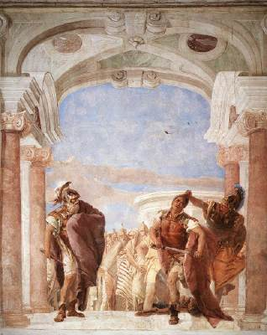
The Rage of Achilles
The battle raged for 9 years and reached a turning point thanks to the macho tendencies of the Greeks. Back then, after killing the men, women were taken as property. Agamemnon (remember him – the brother of Helen’s husband and king of the Greeks) had taken the daughter of a priest of Apollo as a prize of war. This angered Apollo and made him side with the Trojans. Achilles, enraged at Agamemon’s selfishness, convinced the Greeks that Agamemnon should give up his prize. Agamemnon then took Achilles’ trophy girl in retaliation. Achilles refused to fight any more with the Greeks. Silly macho boys!

Slide 11
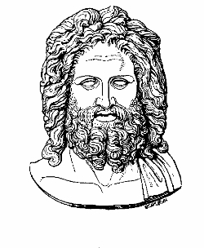
To make things MORE complicated,
other gods and goddesses got
involved in the conflict. For example:
-Hera & Athena wanted Troy
destroyed in retaliation for
losing the golden apple
-Poseidon also sided with the Greeks since they were great sailors
-Aphrodite, logically, sided with Paris and the Trojans since she had won the golden apple.
Artemis and Ares were attached to Apollo and Aphrodite in all things, so they preferred Troy.
Zeus, of course, had to hear all this whining and bickering and try to decide what to do.

Slide 12
Remember that Achilles had been disrespected by the Greeks, so his mom turned against the Greeks and wanted them to lose. She was very beautiful and convinced Zeus, who really liked the Greeks, to side with the Trojans instead.

Slide 13
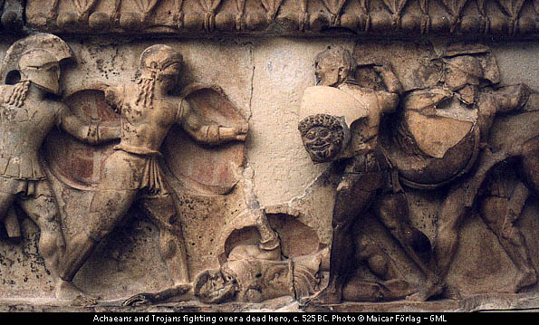
For awhile, things went badly for the Greeks. Achilles refused to fight since the Greeks had taken his girl and dishonored him, and Zeus was working to help the Trojans in order to please Achilles’ hot mama. Hector, meanwhile, slaughtered Greeks left and right on behalf of Troy. Achilles’ best friend Patroclus could not stand to see the Greeks dying, and he borrowed Achilles’ armor to join the battle. He fought bravely until he came face-to-face with Hector, who fatally wounded Patroclus and took Achilles’ armor from the body. (P.S. In the meantime, Menelaus, Helen’s husband fought Paris and was winning until Aphrodite saved Paris. (that wimp) The war SHOULD have ended, but everyone just kept on fighting. Silly macho boys…)

Slide 14
When Achilles heard that Hector had killed his best friend, he became enraged. He was ready to fight again – not to help the Greeks, but to avenge his friend’s death. Slashing his way through the Trojans with his sword, he found Hector and killed him. Although Hector tried to make an agreement with Achilles that they would return the loser’s body to his family & friends, Achilles refused because he was still furious about his friend’s death, and instead he dragged Hector’s body disgracefully around the walls of Troy.

Slide 15
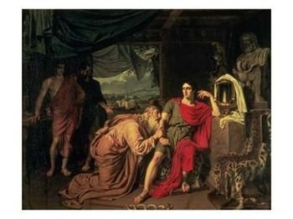
Achilles was pretty darned proud of himself until Hector’s father came and begged for his son’s body. Then Achilles felt guilty, he gave the body back, and all fighting stopped while the Trojans properly mourned great Hector’s death. With great Hector vanquished, Achilles knew he was destined to die soon, as his mother had always warned him.

Slide 16
Today, when we refer to someone’s “Achilles’ heel”, it is a reference to his or her greatest weakness.
Ironically, Paris the wimp caused great Achilles’ death…but only because Aphrodite kept saving him during battle, because Apollo guided the deadly arrow, and because Achilles had one great weakness. As a child, his mother had dipped him in the River Styx to make him invincible. Unfortunately, her hand covered one small part of him…his heel. That is where Apollo guided the deadly arrow shot by Paris, killing Achilles instantly.

Slide 17
The Greeks almost gave up hope after Achilles’ death, but shrewd Odysseus came up with the final daring plan to earn victory.

Slide 18
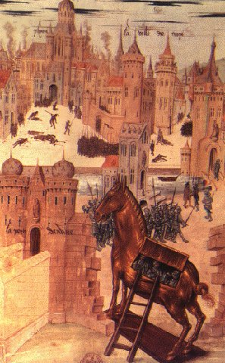
The Greeks knew they had to get within the walls of Troy, so they came up with a tricky plan.
They created a huge wooden horse that would appear to be a gift of surrender to the gods.
They moved their boats to make it look as though they had left.
They left one guy behind to act as a deserter and to explain that the horse was an offering.
The horse was taken inside the walls by the unsuspecting Trojans.
That night, the Greeks, who had been hiding in the hollow horse, climbed out and attacked the Trojans, who were now drunk from partying.
Troy was burned to the ground, and the Greeks won the LONG war.

Slide 19
But that’s only the end of the war story! The journey is yet to begin! Of the 1000 ships that journeyed to Troy, only 100 were left. Odysseus was now a hero, but he still longed for home, and he and the remaining men immediately set sail. Unfortunately, they forgot to thank the gods for their victory, and their trouble begins anew. THAT is the story of…THE ODYSSEY!

