Slide 1
The Holocaust Key Vocabulary
Holocaust: Means “complete destruction by fire.”
Genocide: Deliberate and systematic extermination of a national, racial, political, or cultural group.
Gestapo: The secret police organized in 1933 to uncover and undermine political opposition.
Anti-Semitism: Hostility toward or discrimination against Jewish people.

Slide 2
The Holocaust Key Vocabulary
Totalitarianism: government or doctrine in which the party in power maintains complete control of the government and makes all other parties illegal.
Auschwitz: largest and most notorious death camp
Concentration camp: All non-Aryan race individuals were enclosed behind fences (labor camp).
Death camp: extermination center built by Nazis

Slide 3
Between 1933 and 1945, the German government led by Adolf Hitler and the Nazi Party carried out the systematic persecution and murder of Europe’s Jews. This genocide is now known as the Holocaust.

Slide 4
The Nazi regime also persecuted and killed millions of other people it considered politically, racially, or socially unfit.

Slide 5
In March 1933, Adolf Hitler addressed the first session of the German Parliament (Reichstag) following his appointment as chancellor.
TAKEOVER OF POWER, 1933
Notes:
Berlin, Germany, March 1933
National Archives and Records Administration, College Park, MD

Slide 6
An instructional chart distinguishes individuals with pure “German blood” (left column), “Mixed blood” (second and third columns), and Jews (right two columns), as defined in the Nuremberg Laws.
NAZI RACE LAWS
Notes:
Germany, circa 1935
United States Holocaust Memorial Museum, courtesy of Hillel at Kent State University

Slide 7
The Nazi ideal was the Nordic type, displaying blond hair, blue eyes, and tall stature.
THE “SCIENCE” OF RACE
Notes:
Germany, circa 1935
United States Holocaust Memorial Museum, courtesy of Bildarchiv Preussischer Kulturbesitz

Slide 8
Residents of Rostock, Germany, view a burning synagogue the morning after Kristallnacht (“Night of Broken Glass”). On the night of November 9–10, 1938, the Nazi regime unleashed orchestrated anti-Jewish violence across greater Germany.
“NIGHT OF BROKEN GLASS”
Notes:
Rostock, Germany, November 10, 1938
Archiv der Hansestadt Rostock, Germany

Slide 9
Although Jews were their primary targets, the Nazis also persecuted Roma (Gypsies), persons with mental and physical disabilities, and Poles for racial, ethnic, or national reasons.
“ENEMIES OF THE STATE”
Notes:
Buchenwald, Germany, circa 1938–41
United States Holocaust Memorial Museum, courtesy of Robert A. Schmuhl

Slide 10
Millions more, including homosexuals, Jehovah’s Wit-nesses, Soviet prisoners of war, and political dissidents, also suffered oppression and death.
“ENEMIES OF THE STATE”
Notes:
Buchenwald, Germany, circa 1938–41
United States Holocaust Memorial Museum, courtesy of Robert A. Schmuhl

Slide 11
By the end of 1942, however, the Allies were on the offensive and ultimately drove back the German forces.
THE WAR BEGINS
Notes:
Warsaw, Poland, circa September 1939
United States Holocaust Memorial Museum, courtesy of Julien Bryan

Slide 12
Between 1942 and 1944, trains carrying Jews from German-controlled Europe rolled into one of the six killing centers located along rail lines in occupied Poland.
DEPORTATIONS
Notes:
United States Holocaust Memorial Museum, courtesy of Polskie Koleje Panstwowe S.A., Poland

Slide 13
The overwhelming majority of Jews who entered the Nazi killing centers were murdered in gas chambers—usually within hours of arrival—and their bodies cremated.
CONCENTRATION CAMP UNIVERSE
Notes:
Auschwitz, Poland, May 1944
United States Holocaust Memorial Museum, courtesy of Yad Vashem, Jerusalem, Israel

Slide 14
This photo taken from the window of a private home shows prisoners being marched from one concentration camp to another. In response to the deteri-orating military situation in late 1944, German authorities ordered the evacuation of concentration camp prisoners away from advancing Allied troops to the interior of Germany.
DEATH MARCHES
Notes:
Dachau, Germany, April 1945
akg-images / Benno Gantner

Slide 15
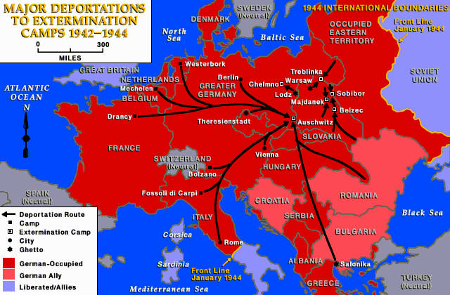

Slide 16
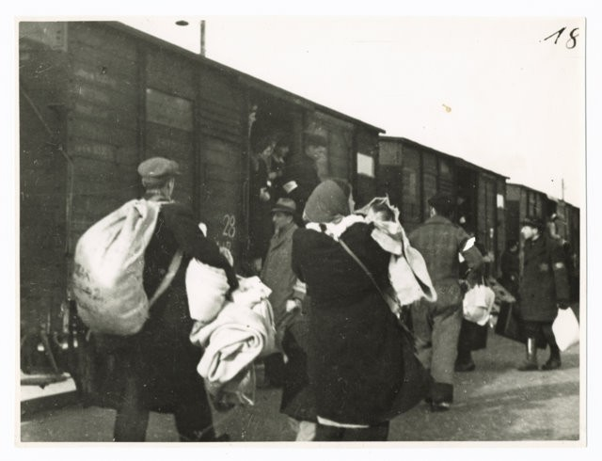

Slide 17
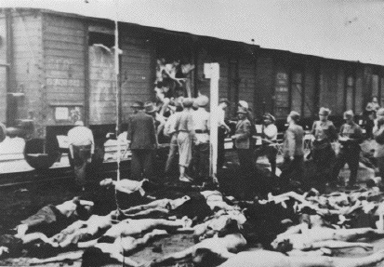

Slide 18
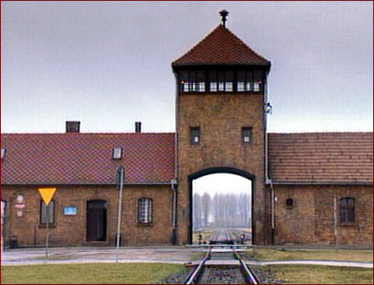

Slide 19
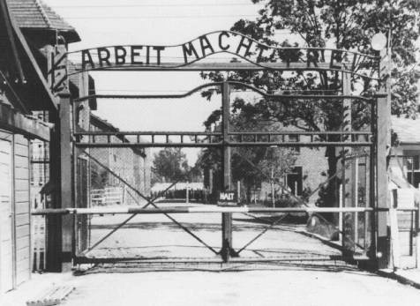
“Arbeit macht frei” (“Work makes you free”)

Slide 20
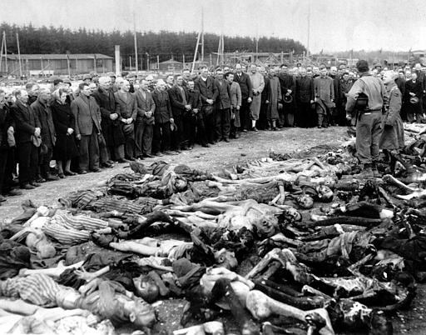

Slide 21
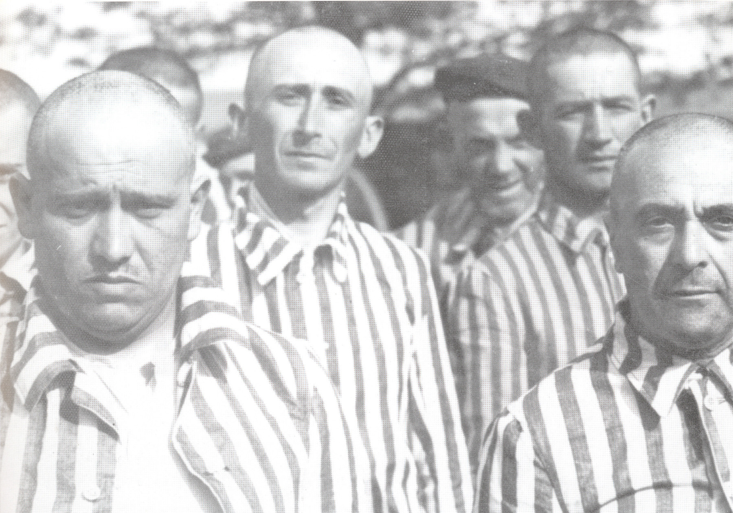

Slide 22
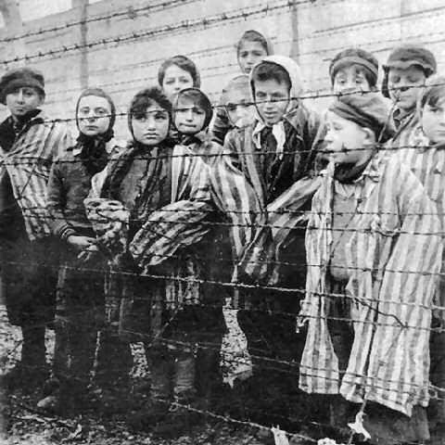

Slide 23
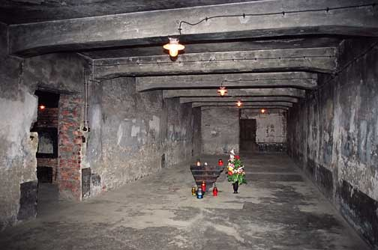
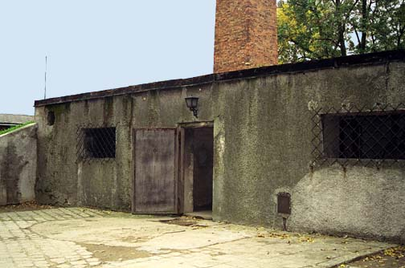

Slide 24
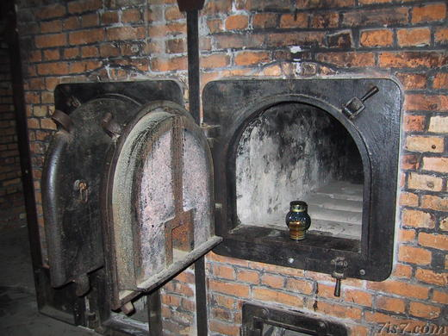

Slide 25
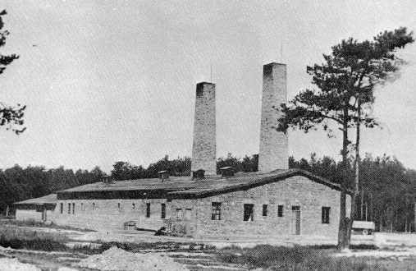

Slide 26
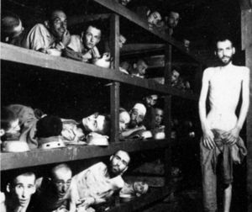
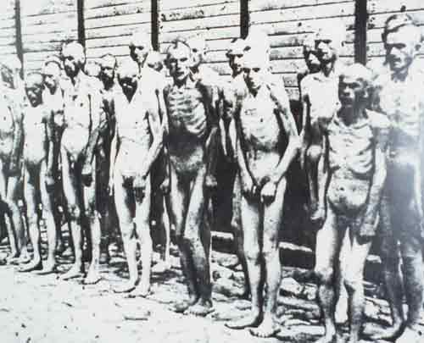

Slide 27
