Slide 1
It’s All Greek to Me
HOW MODERN WORKS ARE DERIVATIVE OF ANCIENT GREEK MYTHOLOGIES

Slide 2
Did you know…..
…that your favorite books and movies are not entirely original?
…Greek Mythologies can be found throughout time in books, music, movies, etc.?
…characters and themes repeat over and over again?

Slide 3
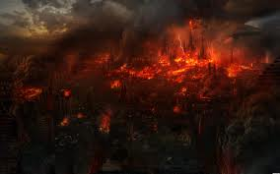
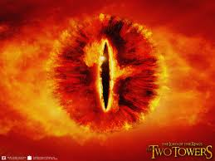
Lord of the Rings (Tolkien)
Lord of the Rings
Q: Does Sauron of Modor remind you of anything?

Slide 4
Hades & The Witch King from LOTR
Hades, god of the underworld, is seen here, and then there’s the Witch King of Angmar from Lord of the Rings

Slide 5
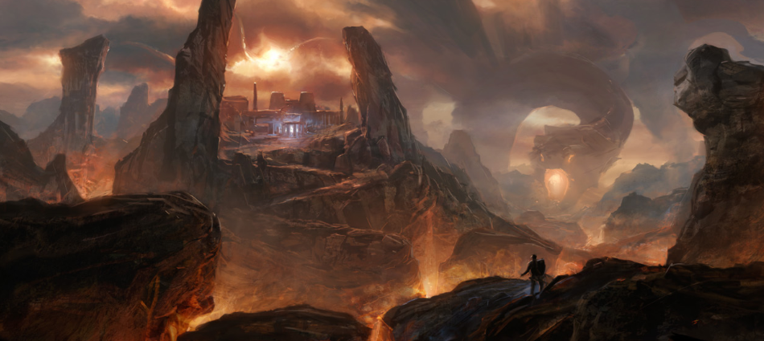
The Underworld/Tartarus vs. Sauron & Mordor

Slide 6
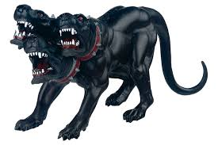
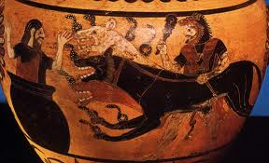
Cerberus
This is Cerberus, the 3 headed watch hound of the underworld & Hades’ pet. Where have you seen a dog like this before?

Slide 7
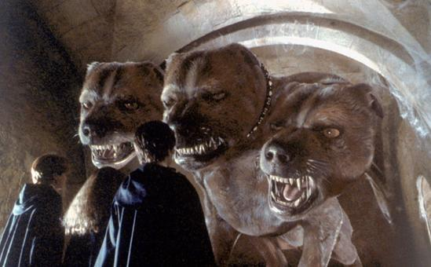
Harry Potter (Rowling)
Harry Potter and the Sorcerer's Stone
FLUFFY!!

Slide 8
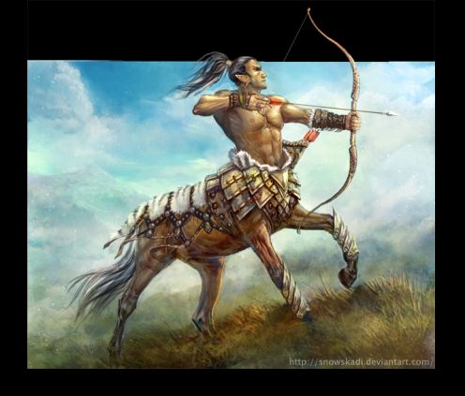
Harry Potter (Rowling)
Harry Potter
Professor Umbridge is taken by Centaurs
http://www.youtube.com/watch?v=rxMQQitMiX4
Centaurs are half-human, half-horse creatures in Greek mythology. They have the body of a horse and the torso, head and arms of a man. They were considered to be the children of Ixion, king of the Lapiths, andNephele, a cloud made in the image of Hera.

Slide 9
Chronicles of Narnia (C.S. Lewis)
Q: How many Greek mythical creatures can you pick out from this battle scene in
“The Lion, The Witch and the Wardrobe”?
https://youtu.be/FixGtngBdhE

Slide 10
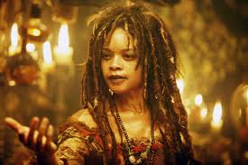
Pirates of the Caribbean
Q: Which Greek Myth involves this character?

Slide 11
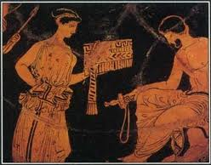
The Odyssey
A: On his epic quest home, Odysseus stops at the Island of Calypso and is so taken by her beauty, is seduced into staying with her for seven years. Hermes, the messenger god, convinces her to let him go home.

Slide 12
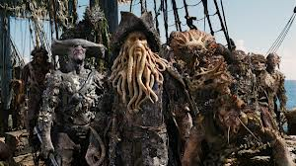
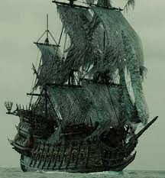
Pirates of the Caribbean
The Flying Dutchman is a ship crewed by the damned and captained by a dead sailor. His job is to see that souls safely reach Davy Jones’ locker.
Q: Which Greek myth does this remind you of?

Slide 13
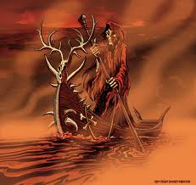
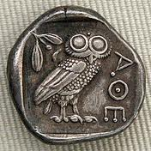
Pirates of the Caribbean
To enter the Underworld, a soul must first pay Charon, the ferryman, to escort them across the river Styx. Some cultures still continue the practice of placing coins onto the eyelids of the dead…to pay the ferryman.

Slide 14
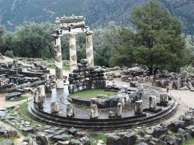
The Oracle at Delphi – Temple of Apollo
Many ancient Greek citizens and mythological heroes sought advice from Apollo, the god of Music, Light and Truth. Apollo’s Oracle at Delphi still stands in ruins after thousands of years. It is a popular tourist attraction.

Slide 15
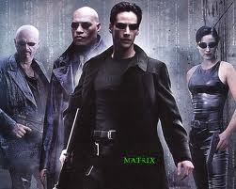
The Matrix
Neo (Greek for “new”) takes advice from the old woman called “the oracle”.
http://www.youtube.com/watch?v=kWVWNri4IFM

Slide 16
Which Movie?
Q: Which popular book/movie was very likely inspired by the following Greek myth?
King Minos was a very clever and cruel ruler of his people. This tyrant of a king built an elaborate maze called a labyrinth, which became the home of the Minotaur, a man-eating beast with the body of a man and the head of a bull. Every nine years, King Minos required seven young men and seven young women to prove their worth as his subjects by attempting safe passage through his perilous maze.

Slide 17
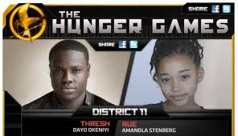
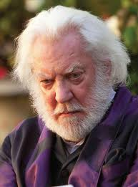
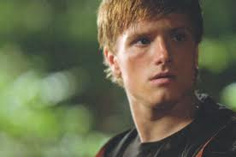
Hunger Games (Collins)

Slide 18
and Harry Potter & the Goblet of Fire

Slide 19
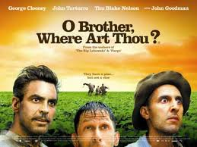
Oh Brother, Where Art Thou?
Movie released in 2000. Setting 1910’s
Modern adaptation of Homer’s “The Odyssey”.
Three men journey towards freedom and fortune.
What parallel’s to The Odyssey you can find?

Slide 20
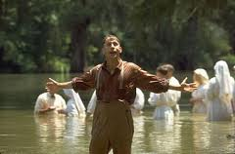
Oh Brother, Where Art Thou?
Clue: Delmar finds a hypnotic distraction among the peaceful believers offering baptism to wash away sins. Once baptized, Delmar doesn’t want to leave until Everett and Pete pull him away.
Clue: A seemingly harmless, one-eyed salesman, turns ruthless.

Slide 21
Oh Brother, Where Art Thou?
Odysseus’ men stop at the Island of the Lotus Eaters. Eating the Lotus flower makes men forget their quest. Odysseus had to tie his men to his ship to force them to leave.
Odysseus and his men encounter a one eyed monster called a Cyclops.

Slide 22
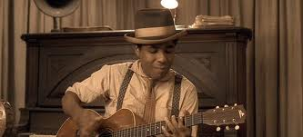
Oh Brother Where Art Thou?
Clue: A wanna-be jazz musician gets a guitar from a “strange man” who promises him the gift of jazz in exchange for his soul.
Clue: Everett, Delmar and Pete pull their car over in response to the sweet, sultry singing of three beautiful ladies in the creek.

Slide 23
Oh Brother Where Art Thou?
It was not uncommon for people to make deals with Hades, God of the Underworld. The theme of selling your soul to the devil has been revisited many times.
Sirens: Women sing alluring songs to men as they sail by in an attempt to draw them in and crash them upon the rocks. Some legends depict sirens as mermaids.

Slide 24
Oh Brother, Where Art Thou?
Much like Odysseus did when he sought advice from the prophet, Teiresias, three men, at the beginning of their journey, encounter a stranger offering advice:
The blind “seer”

Slide 25
Tragic Flaw
Common in Greek mythology is the idea that all heroes have a tragic flaw.
Achilles was a hero of the Trojan War born to a mortal king and a nymph named Thetis. When Achilles was born, Thetis wished to make her son immortal so she dipped him into the river Styx. The water touched him everywhere except his heel where his mother held him. Achilles died when an arrow, shot by Paris, pierced his heal. Today we refer to a person’s major weakness as their “Achilles heel”.

Slide 26
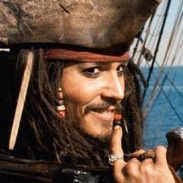
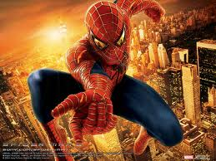
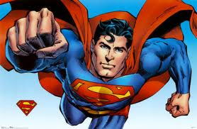
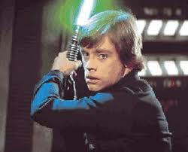
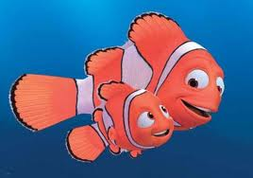
What are the weaknesses of these modern day heroes?
Greed/self preservation
His love for M.J.
Kryptonite
Anger can lead him to the dark side
Fear of losing his son

Slide 27
It’s All Greek to Me
The next time you read a book or watch a movie, see what Greek mythological influences you can find!!

Slide 28
Gallery of the Gods
https://youtu.be/48J7dvwK83g

