Slide 1
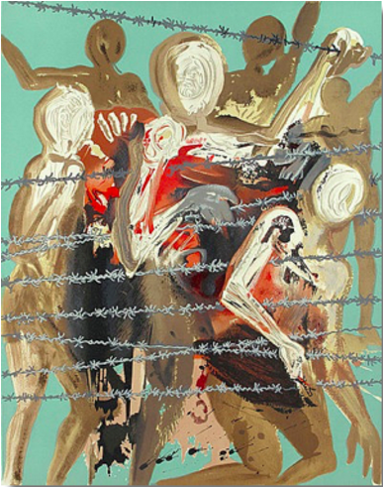
Aliyah: The Rebirth of Israel
Part IV: Shoah
“Out of the Depths”
Salvador Dali

