Slide 1
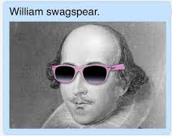
Shakespeare
Movies you didn’t know were based off his plays

Slide 2

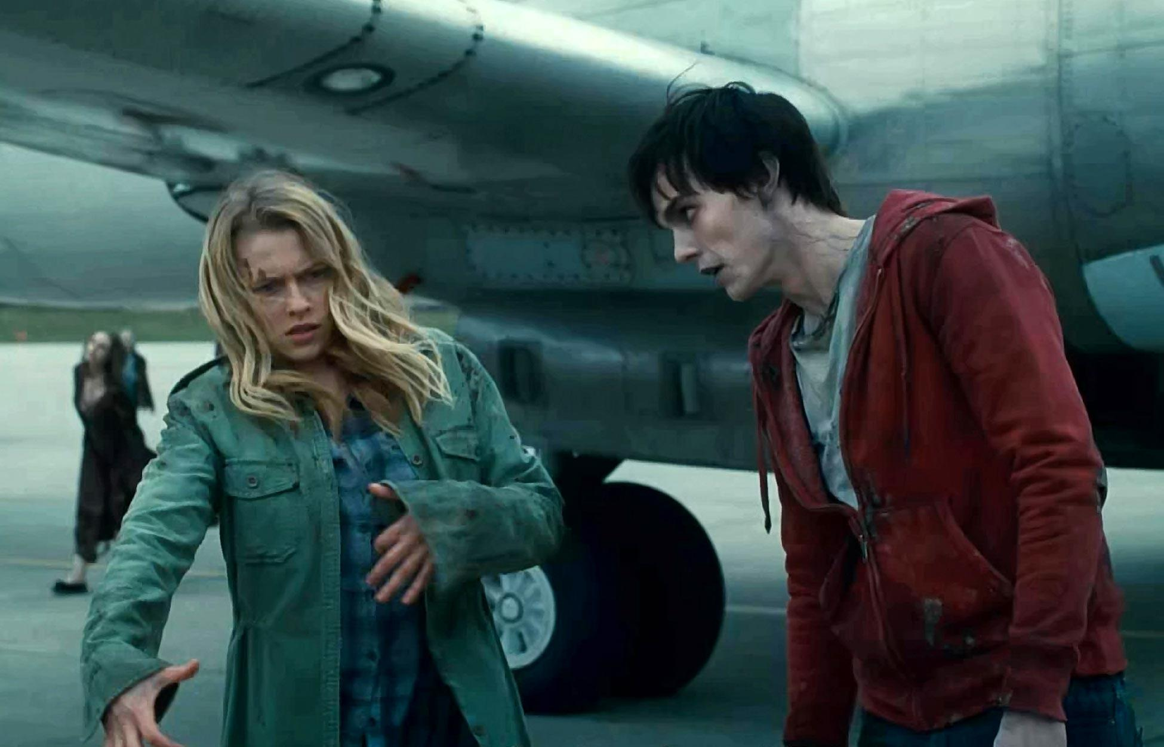
Romeo & Juliet
Warm Bodies

Slide 3
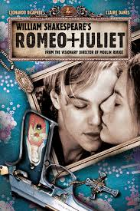
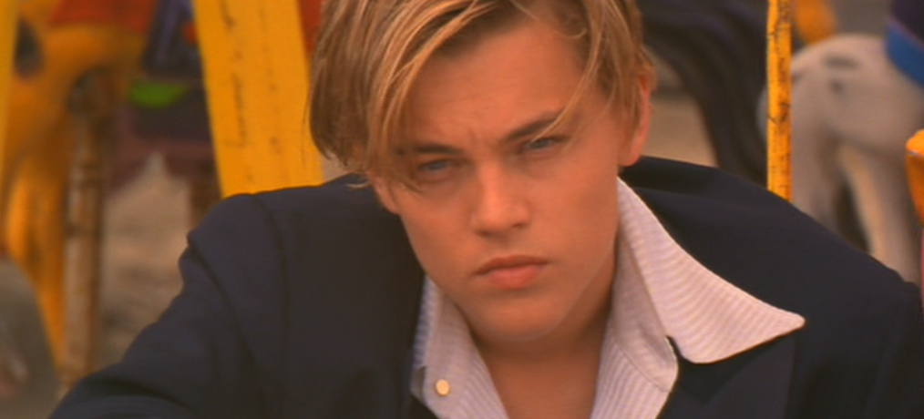
Romeo and Juliet
Romeo and Juliet (1996)

Slide 4
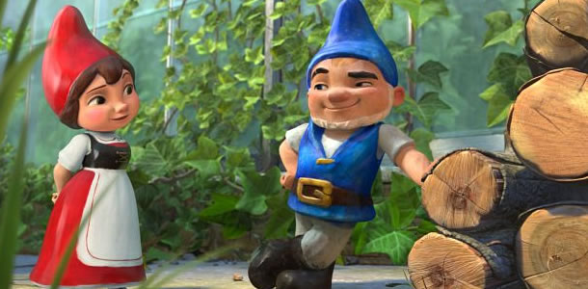
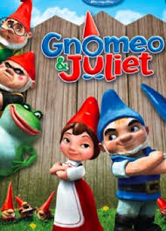
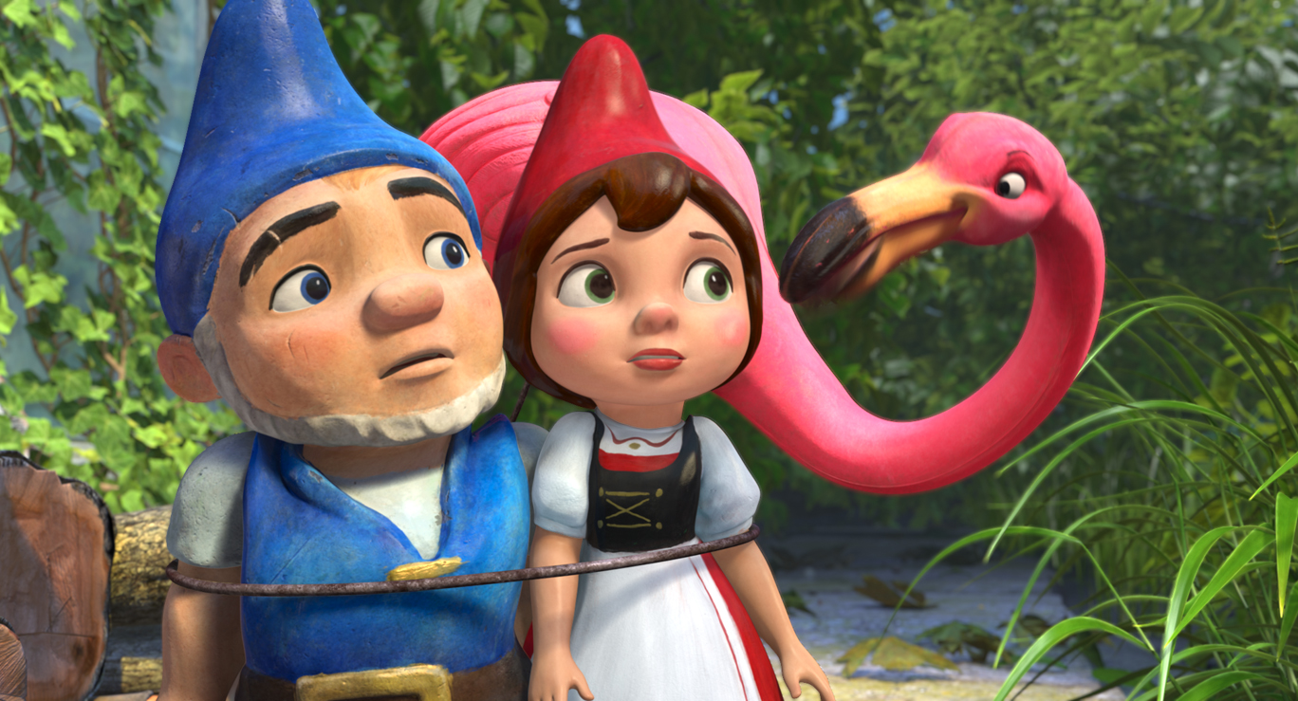
Romeo and Juliet
Gnomeo & Juliet

Slide 5
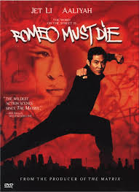
Romeo & Juliet
Romeo Must Die

Slide 6
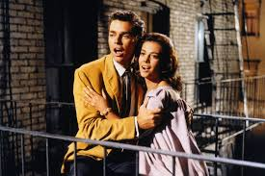
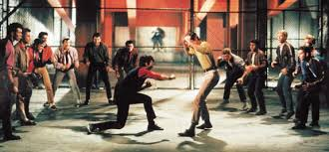
Romeo & Juliet
West Side Story

Slide 7
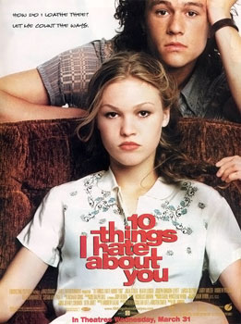

Taming of the Shrew
10 Things I Hate About You

Slide 8
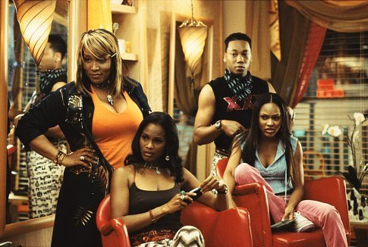
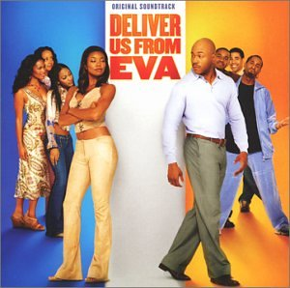
Taming of the Shrew
Deliver Us From Eva

Slide 9

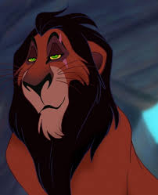
Hamlet
Lion King

Slide 10
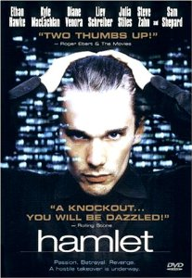
Hamlet
Hamlet (2000)

Slide 11


Hamlet
Sons of Anarchy

Slide 12
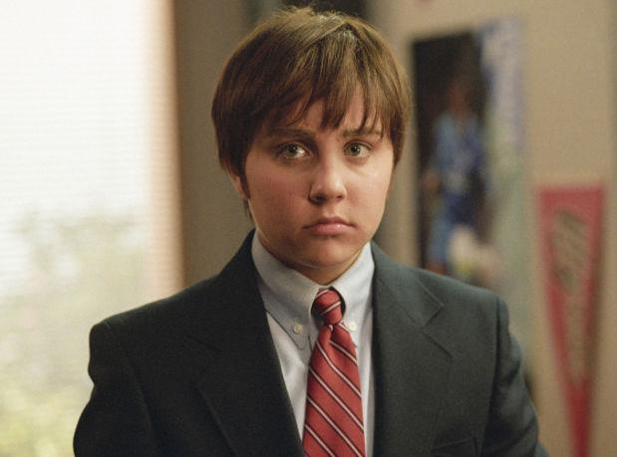

Twelfth Night
She’s the Man

Slide 13
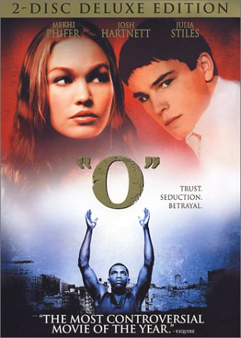
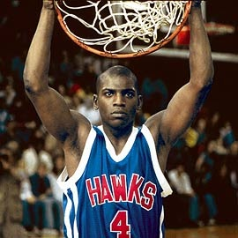
Othello
O

Slide 14
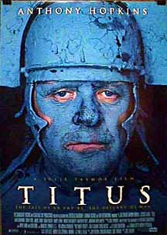

Titus
Titus (1999)

Slide 15
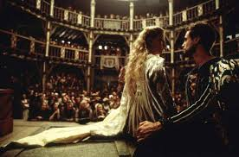
William Shakespeare
Shakespeare In Love

Slide 16

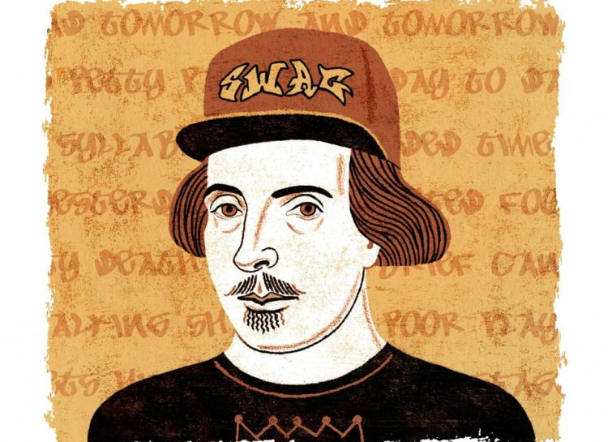

Slide 17
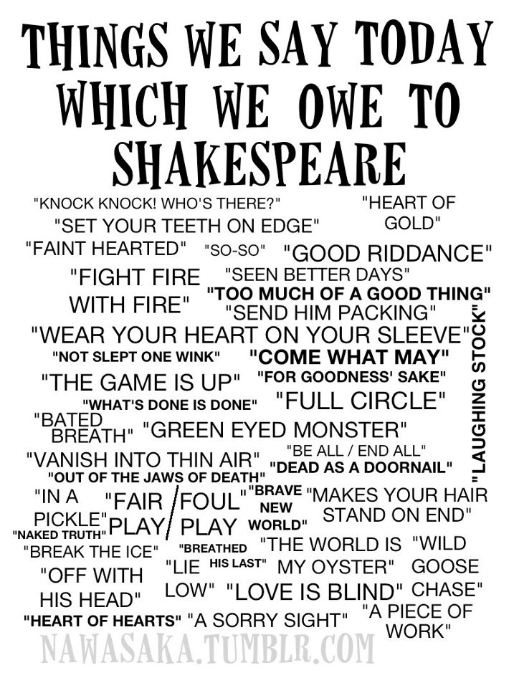
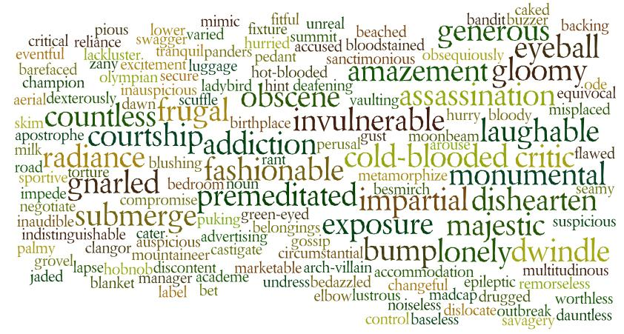
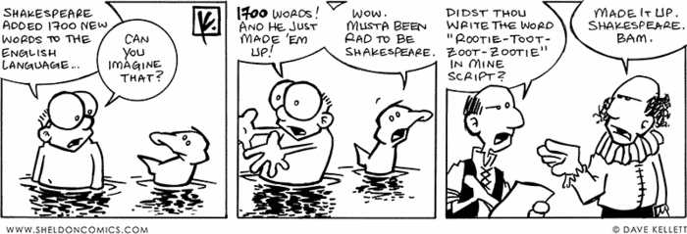

Slide 18
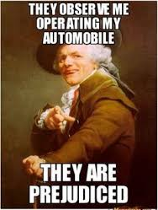
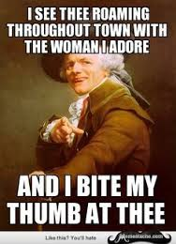
Shakespearean Lingo - Can you guess what they’re saying?

Slide 19
Without Shakespeare, these books would have different titles:
Infinite Jest by David Foster Wallace
The Sound and the Fury by William Faulkner
Brave New World by Aldous Huxley
The Fault in our Stars by John Green
Something Wicked This Way Comes by Ray Bradbury
The Ides of March by Thornton Wilder
Double, Double by Ellery Queen
Full Circle by Peter Straub
All That Glitters by Frances Keyes
Not So Deep as a Well by Dorothy Parker
In Cold Blood by Truman Capote

Slide 21
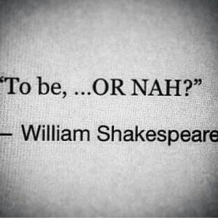

Slide 22
