Slide 1
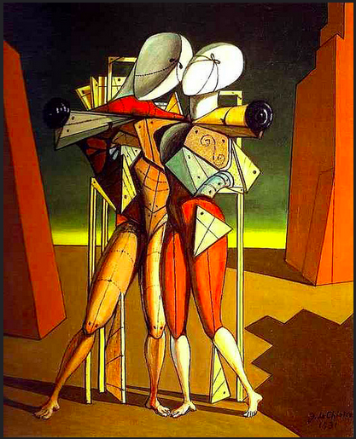
Hector and Andromache
Artist:
Giorgio de Chirico

Slide 2
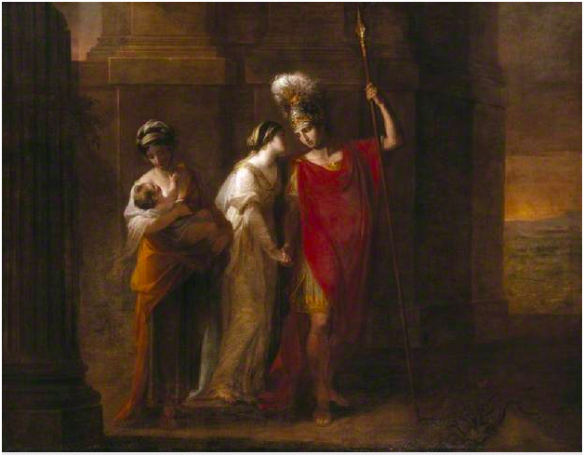
Hector Taking Leave of Andromache
Artist: Angelica Kauffmann

